Slide 1
Micro Credit Defaulters
John Tojo
Data Science Intern

Slide 2
Overview
Introduction
Problem Statement
Exploratory Data Analysis (EDA)
Observations from graphs
Data cleaning
Model Selection
Conclusion
Future Work

Slide 3
Introduction
Microcredit is a common form of microfinance that involves an extremely small loan given to an individual to help them become self-employed or grow a small business.
Today, microfinance is widely accepted as a poverty-reduction tool, representing $70 billion in outstanding loans and a global outreach of 200 million clients.
Micro credit solution provides operators and service providers with the ability to extend their service to their users through a small, short term credit facility.

Slide 4
Problem Statement
The borrowers are generally from low-income backgrounds.
Loans availed under microfinance are usually of small amount, i.e., Loans of value 5& 10 rupees are provided by our client (telecom operator) in collaboration with a Microfinance Institute (MFI).
The loan tenure is short, 5 days
High return (20% ) as well as High risk as it doesn’t require any collateral
These loans are usually repaid at higher frequencies
The purpose of most microfinance loans is income generation

Slide 5
Feature Description
Variable | Definition
label | Flag indicating whether the user paid back the credit amount within 5 days of issuing the loan{1:success, 0:failure}
msisdn | mobile number of user
aon | age on cellular network in days
daily_decr30 | Daily amount spent from main account, averaged over last 30 days (in Indonesian Rupiah)
daily_decr90 | Daily amount spent from main account, averaged over last 90 days (in Indonesian Rupiah)
rental30 | Average main account balance over last 30 days
rental90 | Average main account balance over last 90 days
last_rech_date_ma | Number of days till last recharge of main account
last_rech_date_da | Number of days till last recharge of data account
last_rech_amt_ma | Amount of last recharge of main account (in Indonesian Rupiah)
cnt_ma_rech30 | Number of times main account got recharged in last 30 days
fr_ma_rech30 | Frequency of main account recharged in last 30 days
sumamnt_ma_rech30 | Total amount of recharge in main account over last 30 days (in Indonesian Rupiah)
medianamnt_ma_rech30 | Median of amount of recharges done in main account over last 30 days at user level (in Indonesian Rupiah)
medianmarechprebal30 | Median of main account balance just before recharge in last 30 days at user level (in Indonesian Rupiah)

Slide 6
cnt_ma_rech90 | Number of times main account got recharged in last 90 days
fr_ma_rech90 | Frequency of main account recharged in last 90 days
sumamnt_ma_rech90 | Total amount of recharge in main account over last 90 days (in Indonasian Rupiah)
medianamnt_ma_rech90 | Median of amount of recharges done in main account over last 90 days at user level (in Indonasian Rupiah)
medianmarechprebal90 | Median of main account balance just before recharge in last 90 days at user level (in Indonasian Rupiah)
cnt_da_rech30 | Number of times data account got recharged in last 30 days
fr_da_rech30 | Frequency of data account recharged in last 30 days
cnt_da_rech90 | Number of times data account got recharged in last 90 days
fr_da_rech90 | Frequency of data account recharged in last 90 days
cnt_loans30 | Number of loans taken by user in last 30 days
amnt_loans30 | Total amount of loans taken by user in last 30 days
maxamnt_loans30 | maximum amount of loan taken by the user in last 30 days
medianamnt_loans30 | Median of amounts of loan taken by the user in last 30 days
cnt_loans90 | Number of loans taken by user in last 90 days
amnt_loans90 | Total amount of loans taken by user in last 90 days
maxamnt_loans90 | maximum amount of loan taken by the user in last 90 days
medianamnt_loans90 | Median of amounts of loan taken by the user in last 90 days
payback30 | Average payback time in days over last 30 days
payback90 | Average payback time in days over last 90 days
pcircle | telecom circle
pdate | date

Slide 7
Exploratory Data Analysis (EDA)
Step 3 :
check for duplicates and dropped duplicated rows
checked for columns having more than 80% value as zero and dropped those columns
Step 5 : check for columns having negative values
Aon and last_rech_date_ma cant be negative. Dropped those rows were negative values were present
Step 1 The data provided had 209593 rows and 35 columns the date column was divided into 3 day, month and year
Step 4 Separated columns into 3 categories
Numerical discrete
Numerical continuous
Categorical features were absent
Step 6 : aon and last_rech_date_ma
Aon and last_rech_date_ma cant have values greater than 22000 , when it is converted to years it is 60 years
Step2 : Checked for unique values
Dropped Unnamed: 0 as all values were unique
dropped pcircle and year as it had 1 unique data
Dropped msisdn as it was mobile no

Slide 8
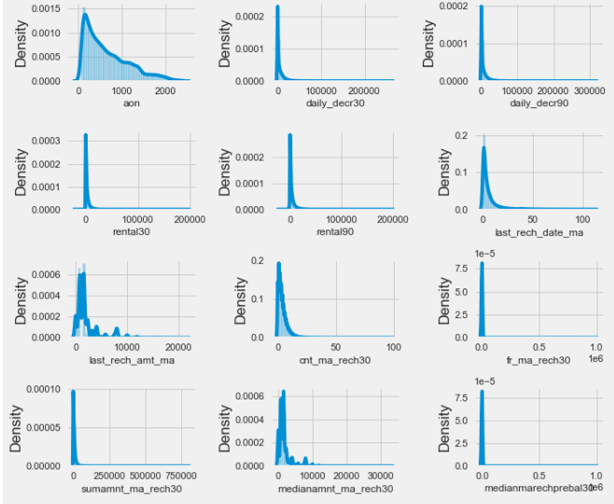
Univariate Analysis numerical continuous
the datas are highly skewed
presence of outliers of outliers

Slide 9
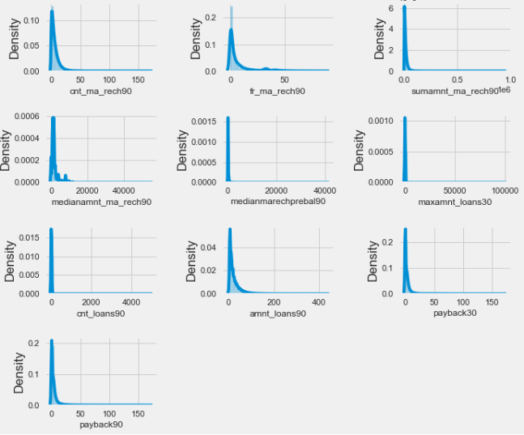
Univariate Analysis numerical continuous
the datas are highly skewed
presence of outliers of outliers

Slide 10
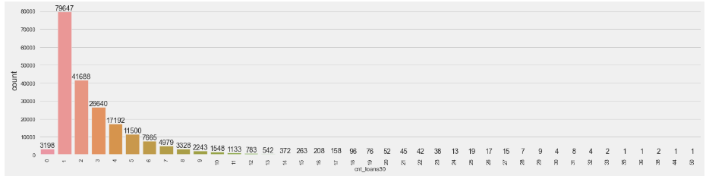
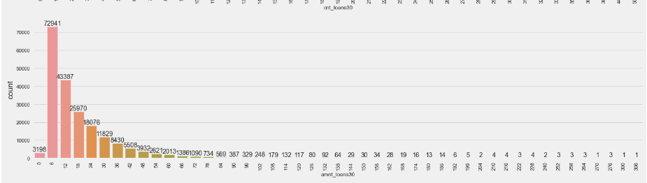
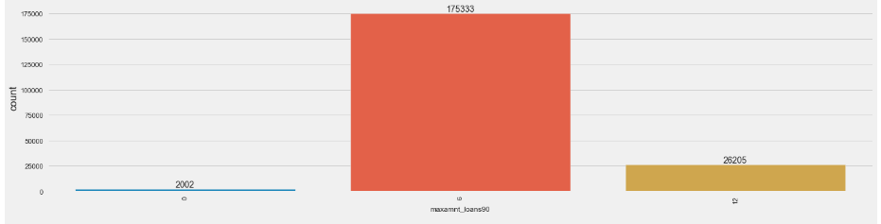
Univariate Analysis numerical discrete
cnt_loans30
most of the customers have taken 1 loan in past 30 days
there are some cases where no of loans taken are more than 20
amnt_loans30
total amount of loan taken by the customer in the past 30 days is mostly 6 followed by 12
maxamnt_loans90
the max amount of loans taken by cusomter in 90 days is 6

Slide 11
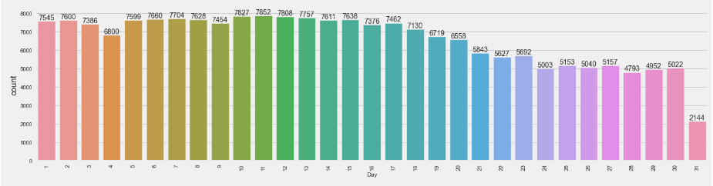
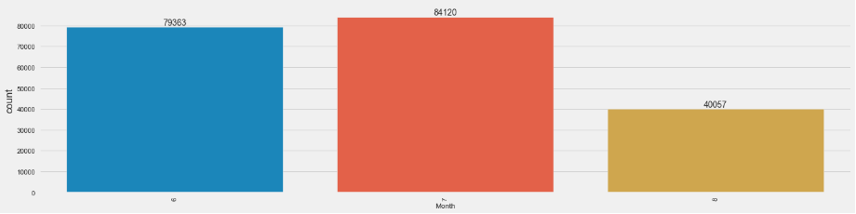
Univariate Analysis numerical discrete
Day
days 6, 7, 10, 11, 12 has the largest amount of data
Month
7th month has most no of data

Slide 12
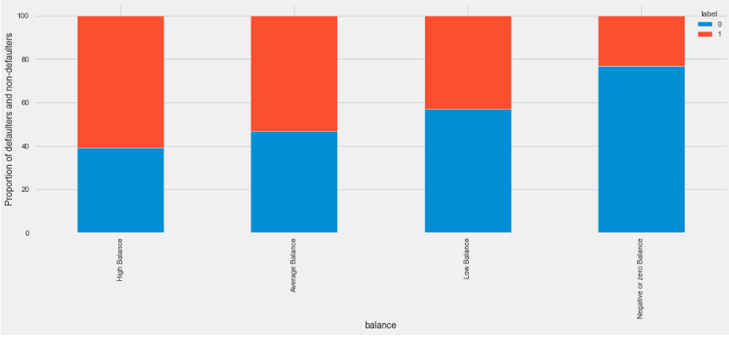
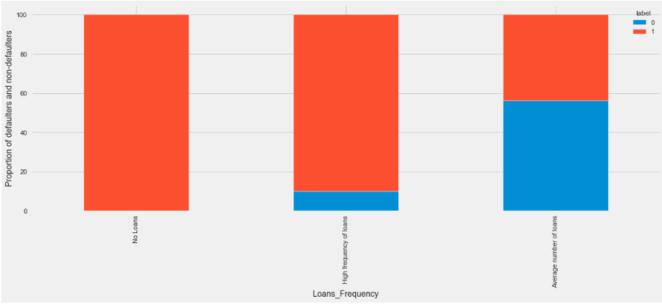
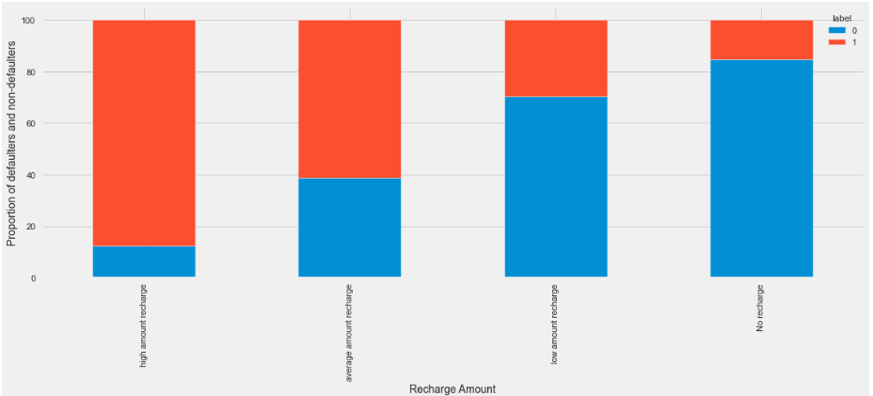
Bivariate Analysis
negative or zero balance have high chance to default
customers who take loans in the range 0-5 have high chance to default
customers those who dont recharge their accounts have a chance to default

Slide 13
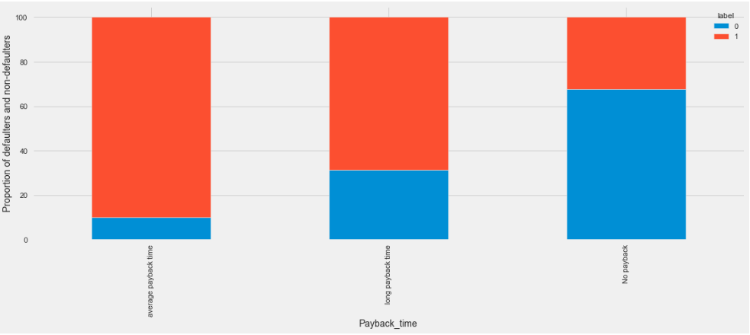
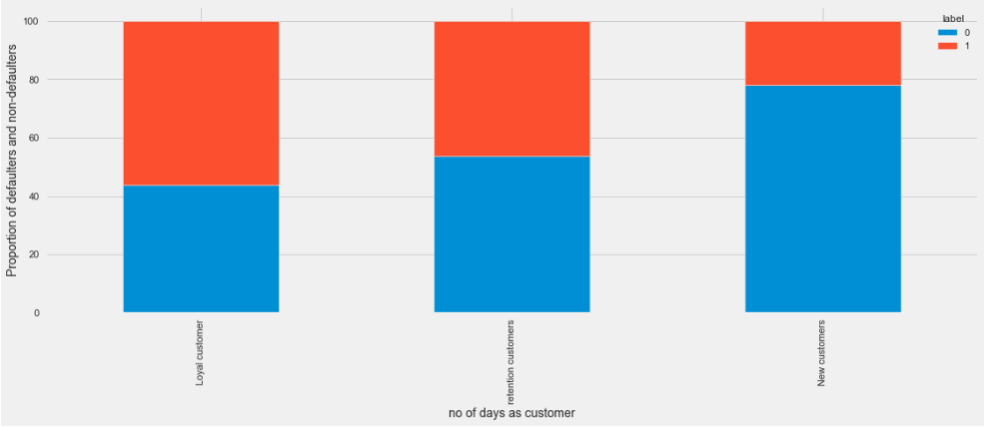
Bivariate Analysis
defaulters are high for those who have not paid back
defaulters are highest among new customers

Slide 14
DATA CLEANING STEPS
Check for skewness: few columns were not within the limits
Used power transform (yeo-johnson) method to reduce the skewness
Tried to reduce skewness further by using cube root, followed by power transform for those columns which were not within limits
As skewness was not reducing dropped those columns whose skewness exceed the limit of 0.65 to -0.65
Outliers check: outliers were checked and treated using zscore method. The net data loss after removing outliers and dropping rows earlier has resulted in loss of 6.82% within limits
Check correlation:
used to get an idea how the features were correlated to target and found that most of the features were weakly correlated to target,
later heatmap is plotted to see how the feature to feature correlation and vif is used to check for multicollinearity
Vif was not within the limits ie less than 10 hence dropped the following columns daily_decr90, amnt_loans30, sumamnt_ma_rech30, cnt_ma_rech90, amnt_loans90, rental90, sumamnt_ma_rech90
Imbalanced Dataset: as the dataset was imbalanced used smote at 75% to balance the target class

Slide 15
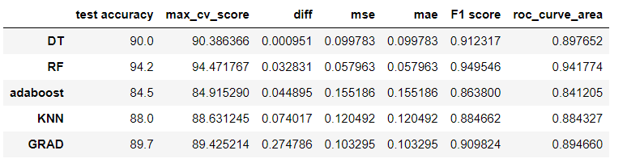
Model Selection
The target variable is label which is numerical discrete datatype which take 0 and 1 classifiacation problem
Different models used were:
Random Forest
Adaboost classifier
Gradientboost classifier
Decision Tree
KNN
Random Forest is the best model
highest roc_curve area
highest test accuracy and cv_score
2nd highest in difference between cv_score and test accuracy
least error compared to other model
highest F1score, precision and recall
importance is to reduced FN, which implies that in actual case its default but prediction is not defaulter, the least value of FN is for KNN, followed by RF

Slide 16
Conclusion
a. The customers who maintain a negative or zero
balance or more likely to default followed by low
balance accounts
b. The customers who have moderate frequency of
taking loans have higher chance to default
c. The customers who fail to recharge their account
could potentially end up defaulting followed by low
amount recharge in their account
d. Customers who don’t payback or have longer
duration of payback have very high chance to
default
e. It can be noted that new customers are more likely
to default, followed by retained customers
f. Most of the defaulting was done on month 6
g. Customers who take loan on 22nd have high chance
to default

Slide 17
Future Works
a. The data had large number of unrealistic data present and outliers, while cleaning the data it
was difficult to reduce the data loss within the specified limit. As the data was bought it should be taken care not to have such unrealistic data as much as possible
b. The data given were highly skewed
c. More factors should be taken into account such as the income of the person who is taking the loan and assign a credit score so that it is possible to cluster the customers based on it and reduce the defaulting rate

Slide 18


